Slide 1
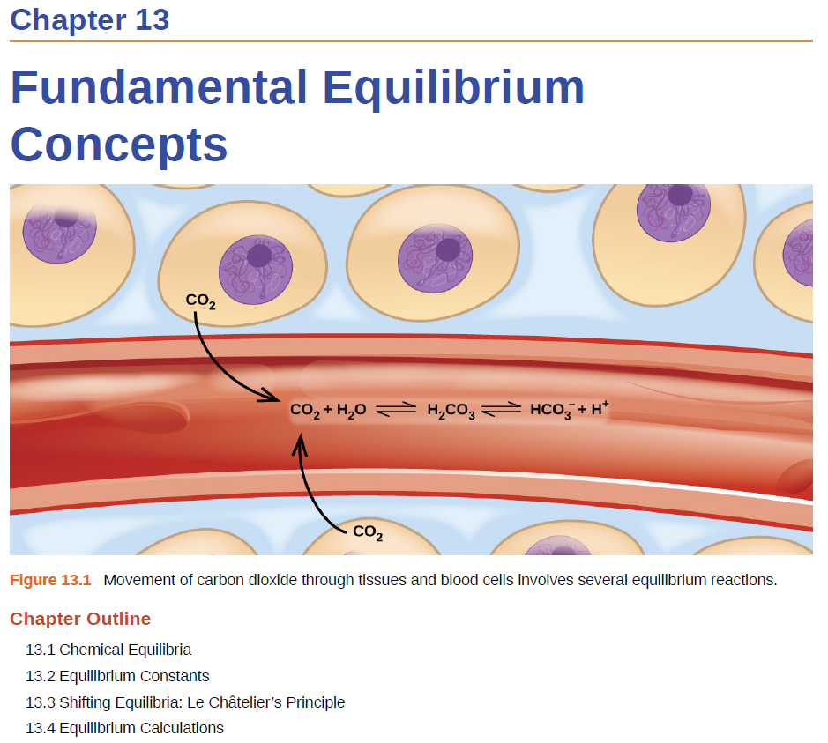


Slide 2
Equilibrium Constant
For a general reversible reaction such as:
aA + bB cC + dD
Equilibrium constants can be expressed using K_{c} or K_{p}.
K_{c} uses the concentration of reactants and products.
K_{p} uses the pressure of the gaseous reactants and products.
[C]^{c}
[D]^{d}
K_{c} =
[A]ª
[B]^{b}
P_{C}^{c}
P_{D}^{d}
K_{p} =
P_{A}ª
P_{B}^{b}
I have K, now what?

Slide 3
I have K, now what?
We can:
Predict the direction in which a reaction mixture will proceed to reach equilibrium.
Calculate the concentration of reactants and products once equilibrium has been reached.
Predict if and which direction the equilibrium will shift upon perturbation.
Notes:
Only true for point of equilibrium.

Slide 4
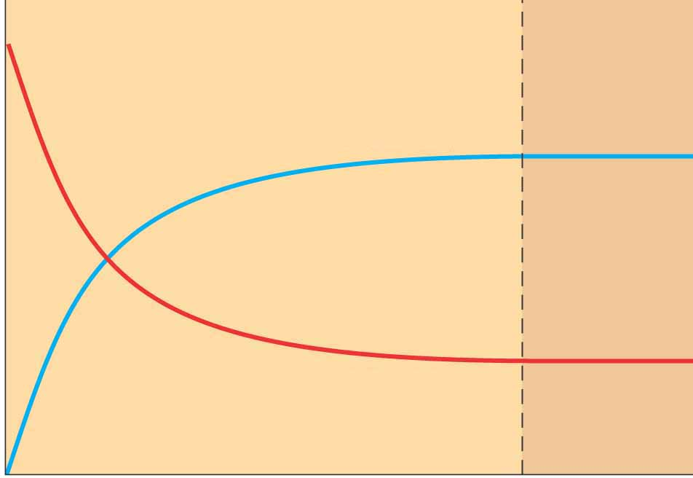
Reaction Quotient
Reaction Quotient- is a function of the concentrations or pressures of the chemical species involved in a chemical reaction.
A B
B
Number
A
At any time
time
At equilibrium
[B]
[B]
Q
=
K
=
[A]
[A]

Slide 5
Reaction Quotient
The reaction quotient Q has the same form as the equilibrium constant K
The major difference between Q and K is that the concentrations used in Q are not necessarily equilibrium values.
aA + bB cC + dD
Q can be calculated at any time!

Slide 6
Reaction Quotient
Why do we need Q if it does not use equilibrium concentrations?
The reaction quotient will help us predict how the equilibrium will respond to an applied stress:
aA + bB cC + dD
Q = K_{c}: the system is at equilibrium
Q < K_{c}: the reaction proceeds to the right
Q > K_{c}: the reaction proceeds to the left

Slide 7
Reaction Quotient
aA + bB cC + dD
[C]^{c}
[D]^{d}
[C]^{c}
[D]^{d}
Q =
K =
[A]ª
[B]^{b}
[A]ª
[B]^{b}
Q = K_{c}: the system is at equilibrium
concentration of reactants and products stays the same
Q < K_{c}: the reaction proceeds to the right
generate more products, consume more reactant
Q > K_{c}: the reaction proceeds to the left
consume more products, generate more reactant
Can predict which way will it shift.

Slide 8
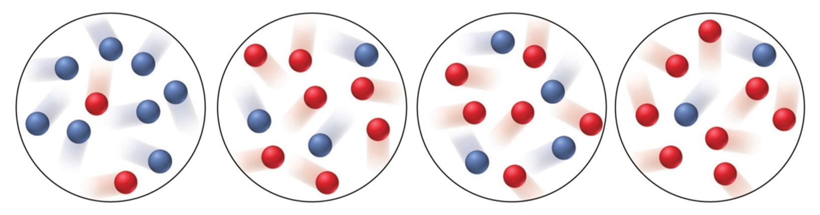
Clicker question (AC):
A_{(g)} B_{(g)}
The equilibrium mixture at 175°C is [A] = 2.8x10⁻⁴ M and [B] = 1.2x10⁻⁴ M. The molecular scenes below represent mixtures at various times during runs A-D of this reaction.
A
B
C
D
Which mixture is at equilibrium?

Slide 9
Clicker question (AC):
[B]
1.2x10⁻⁴
K_{c} =
=
= 0.43
A_{(g)} B_{(g)}
[A]
2.8x10⁻⁴
The equilibrium mixture at 175°C is [A] = 2.8x10⁻⁴ M and [B] = 1.2x10⁻⁴ M. The molecular scenes below represent mixtures at various times during runs A-D of this reaction.
A
B
C
D
# B
8
3
4
2
Q =
=
= 4
= 0.43
= 0.67
= 0.25
# A
2
7
6
8
Which mixture is at equilibrium?

Slide 10
Clicker question (AC):
[B]
1.2x10⁻⁴
K_{c} =
=
= 0.43
A_{(g)} B_{(g)}
[A]
2.8x10⁻⁴
The equilibrium mixture at 175°C is [A] = 2.8x10⁻⁴ M and [B] = 1.2x10⁻⁴ M. The molecular scenes below represent mixtures at various times during runs A-D of this reaction.
A
B
C
D
Q = 4
0.43
0.67
0.25
Will mixture A:
a) Generate more B_{(g)}
b) Generate more A_{(g)}
c) Stay the same

Slide 11
Clicker question (AC):
[B]
1.2x10⁻⁴
K_{c} =
=
= 0.43
A_{(g)} B_{(g)}
[A]
2.8x10⁻⁴
The equilibrium mixture at 175°C is [A] = 2.8x10⁻⁴ M and [B] = 1.2x10⁻⁴ M. The molecular scenes below represent mixtures at various times during runs A-D of this reaction.
A
B
C
D
Q = 4
0.43
0.67
0.25
Will mixture D:
a) Proceed to the left
b) Proceed to the right
c) Stay the same

Slide 13


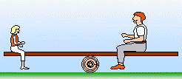
Factors that Affect Equilibrium
At equilibrium:
aA + bB cC + dD
A chemical system at equilibrium is a balance between forward and reveres reactions.
An external perturbation can change the rates of the forward and reverse reactions.
Such disturbance usually leads to a shift from the established chemical equilibrium.

Slide 14
Factors that Affect Equilibrium
At equilibrium:
aA + bB cC + dD
How we will “poke” our equilibrium:
Concentration
Pressure
Temperature
Catalyst

Slide 15
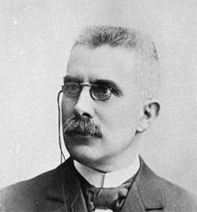
Le Châtelier’s Principle
When a chemical system at equilibrium is disturbed, it returns to equilibrium by undergoing a net reaction that reduces the effect of the disturbance.
1) The system is at equilibrium.
2) We poke/stress/disturb the system.
3) The system is no longer at equilibrium.
4) LCP says system will react and return to equilibrium.
Henry Le Châtelier
(1850-1936)

Slide 16
Change in Concentrations
aA + bB cC + dD
1) The system is at equilibrium.
2) We poke/stress/disturb the system.
double the concentration of D
3) The system is no longer at equilibrium.
4) LCP says system will react and return to equilibrium.
[C]^{c}
[D]^{d}
K =
[A]ª
[B]^{b}
[C]^{c}
[2D]^{d}
Q =
[A]ª
[B]^{b}
Q > K
The reaction will “shift left”

Slide 17
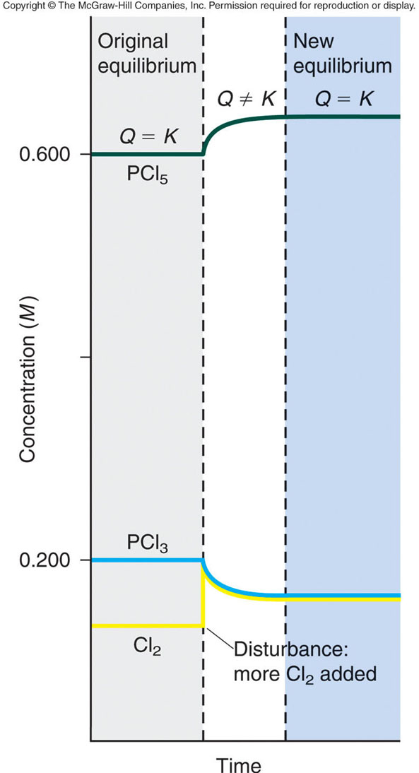
Change in Concentrations
PCl_{3(g)} + Cl_{2(g)} PCl_{5(g)}
P_{PCl5}
K =
P_{PCl3}
P_{Cl2}
The system is at equilibrium.
Q = K
2) We add Cl_{2(g)}.
3) The system is no longer at equilibrium.
Q < K
4) LCP says system will react and return to equilibrium (Q = K).
↓ PCl₃ ↓ Cl₂ ↑ PCl₅
A change in conc has no effect on the value of K!

Slide 18
Change in Concentrations
aA + bB cC + dD
[C]^{c}
[D]^{d}
K =
[A]ª
[B]^{b}
Change
Shifts the Equilibrium
Add [products]
left
Remove [products]
right
Add [reactants]
right
Remove [reactants]
left
To reach equilibrium again:
Left Shift: decrease in [products], increase in [reactants]
Right Shift: decrease in [reactants], increase in [products]

Slide 19
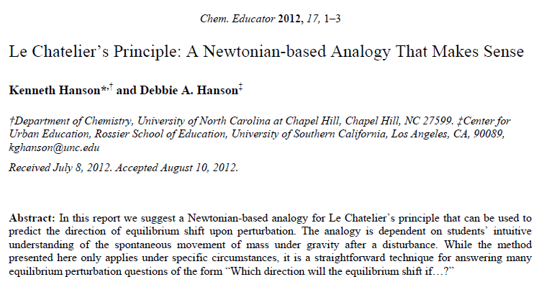
Change in Concentrations
Rather than memorize the rules or calculate Q every time, I propose an alternative strategy:
The Hanson method

Slide 20
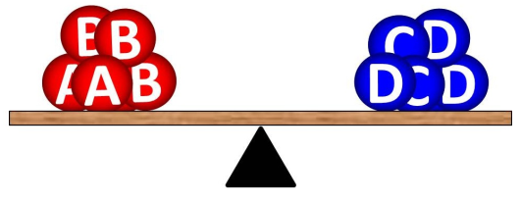
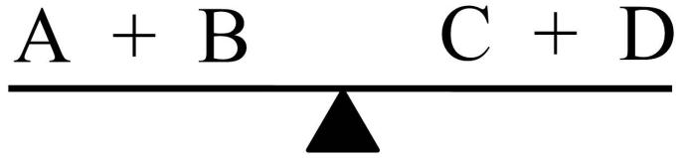
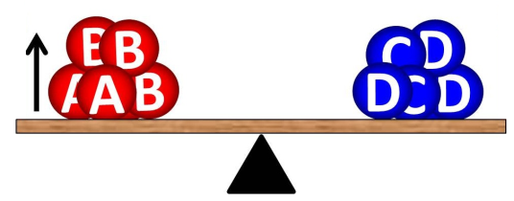
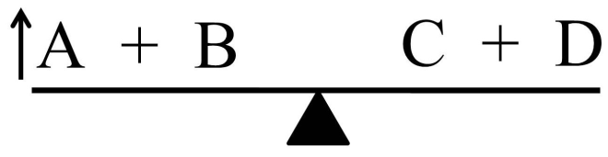
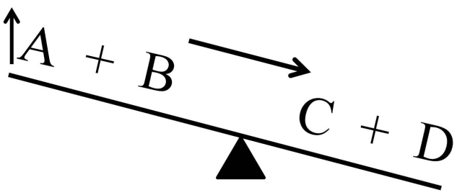
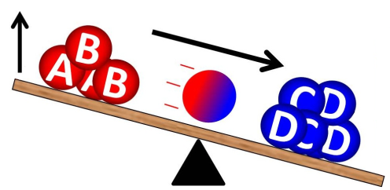
Change in Concentrations
A + B C + D
Step 1: Visualize or draw the equilibrium as a see-saw with the fulcrum under the equilibrium arrow.
Step 2: Which ever component is being added (removed), visualize an up (down) arrow attached to that side of the see-saw. For addition of A:
Step 3: Which ever component is being added (removed), visualize an up (down) arrow attached to that side of the see-saw. For addition of A:
Reaction shifts right!

Slide 21
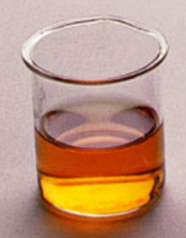
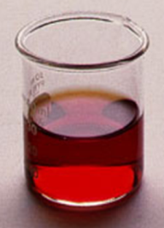
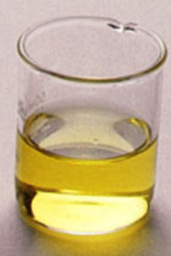
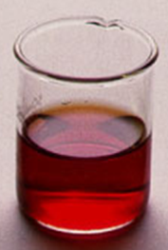
Example Problem
FeSCN²⁺_{(aq)} Fe³⁺_{(aq)} + SCN⁻_{(aq)}
red
yellow
colorless
Which way does the reaction shift if:
we add NaSCN?
FeSCN²⁺_{(aq)} Fe³⁺_{(aq)} + SCN⁻_{(aq)}
we add C₂O₄²⁻ (Fe³⁺ + C₂O₄²⁻ → Fe(C₂O₄)₃³⁻)?
FeSCN²⁺_{(aq)} Fe³⁺_{(aq)} + SCN⁻_{(aq)}
we add Fe(NO₃)₃?
FeSCN²⁺_{(aq)} Fe³⁺_{(aq)} + SCN⁻_{(aq)}

Slide 22
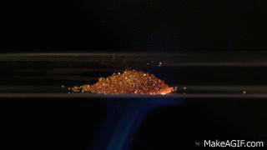
Change in Concentrations
P
P
K_{p} =
CO₂
O₂
Double the amount of oxygen.
P
2P
Q =
CO₂
Q < K
C_{(s)} + O_{2(g)} CO_{2(g)}
O₂
Question:
LCP says system will react and return to equilibrium.
Will doubling O₂:
Shift right
Shift left
Stay the same
↓ O₂ ↑ CO₂

Slide 23
Change in Concentrations
P
P
K_{p} =
CO₂
O₂
Double the amount of C.
P
P
Q =
CO₂
Q = K
C_{(s)} + O_{2(g)} CO_{2(g)}
O₂
Question:
Important Note: Only substances that appear in the expression for Q can have an effect (ignore changes in solid (s) or liquids (l)).
Will doubling C_{(s)}:
Shift right
Shift left
Stay the same

Slide 24
Clicker question (AC):
To improve air quality and obtain a useful product, chemists often remove sulfur from coal and natural gas by treating the contaminant hydrogen sulfide with O₂:
2H₂S_{(g)} + O_{2(g)} 2S_{(s)} + 2H₂O_{(g)}
What happens to:
(1) [H₂O] if O₂ is added?
(2) [H₂S] if O₂ is added?
increase
decrease
stay the same
increase
decrease
stay the same
(3) [O₂] if H₂S is removed?
(4) [H₂S] if sulfur is added?
increase
decrease
stay the same
increase
decrease
stay the same

Slide 25

Factors that Affect Equilibrium
At equilibrium:
aA + bB cC + dD
How we will “poke” our equilibrium:
Concentration
Pressure
Temperature
Catalyst

Slide 26
Change in Pressure
A_{(g)} + B_{(g)} C_{(g)}
We can change pressure in a reaction vessel three different ways:
1) Add A, B or C
Changing the concentration of a gaseous component causes the equilibrium to shift according to LCP.
2) Increasing or decreasing the volume of the chamber.
3) Adding an inert gas (a gas not involved in the rxn).
Changes in pressure (volume) have no effect on the value of K.

Slide 27
2) Change in Volume
A_{(g)} + B_{(g)} C_{(g)}
Changing the volume/pressure of a reaction will have little influence on liquid, aqueous or solid species.
Concentration of gases are greatly affected by pressure and volume changes according to the ideal gas law.
Increasing pressure (or reducing volume) effectively increase the concentration of gasses.
PV = nRT
P = (n/V)RT
P ∝ 1/V

Slide 28
2) Change in Volume
A_{(g)} + B_{(g)} C_{(g)}
When the pressure is increased (or volume is decreased), the reaction proceeds to decrease the total amount of moles of gaseous substances involved in the reaction.
This effectively lowers the total pressure in the reaction vessel.
If the total number of moles of gaseous reactants equals to the total number of moles of gaseous products, the equilibrium is not affected by pressure or volume changes.
AKA- Changes in V or P will cause equilibrium to shift if Δn_{gas} ≠ 0.

Slide 29

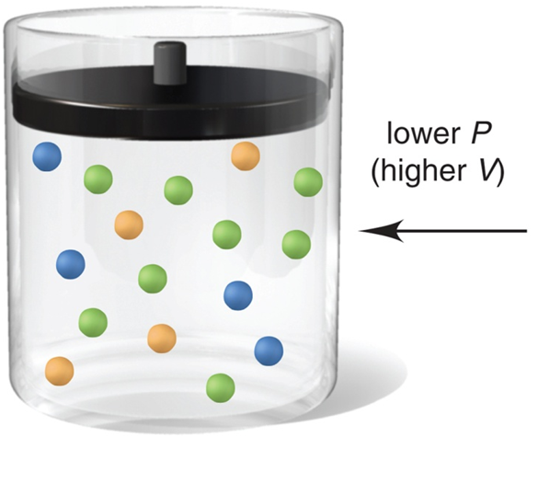
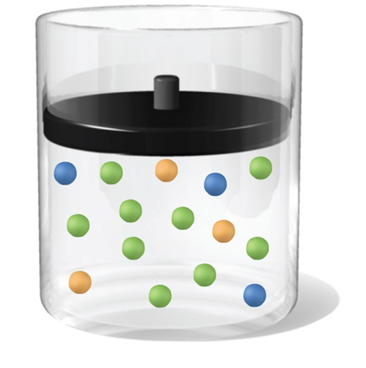
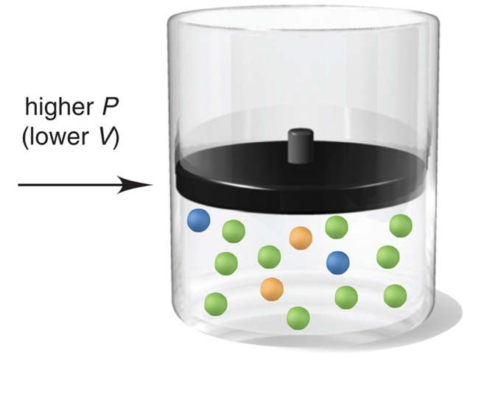

2) Change in Volume
_{(g)}
_{(g)}
_{(g)}
_{(g)}
_{(g)}
_{(g)}
_{(g)}
_{(g)}
_{(g)}
Shift in the direction with more gas molecules.
Shift in the direction with less gas molecules.

Slide 30
2) Change in Volume
A_{(g)} + B_{(g)} C_{(g)}
Change
Shifts the Equilibrium
Shift
Increase volume
Side with most moles of gas
left
Decrease volume
Side with fewest moles of gas
right
Changes in V will not cause the equilibrium to shift if Δn_{gas} = 0.
A_{(g)} + B_{(g)} C_{(g)} + B_{(g)}
or
A_{(g)} + B_{(g)} 2C_{(g)}

Slide 31
3) Adding an Inert Gas
Adding an inert gas has no effect on the equilibrium position, as long as the volume does not change.
Inert gas = a gas not involved in the reaction.
This is because all concentrations and partial pressures remain unchanged.
C_{(s)} + O_{2(g)} CO_{2(g)}
P
P
Add N₂ to the reaction chamber.
K_{p} =
CO₂
O₂
P
P
Q =
CO₂
Q = K
O₂

Slide 32
Change in Pressure
A_{(g)} + B_{(g)} C_{(g)}
We can change pressure in a reaction vessel three different ways:
1) Add A, B or C
-Changing the concentration of a gaseous component causes the equilibrium to shift according to LCP.
-Changing [Solids] and [liquids] do not influence the equilibrium.
2) Increasing or decreasing the volume of the chamber.
-Decreasing volume favors side with less gas molecules.
-Changes in volume do not affect s, l or aq species.
3) Adding an inert gas (a gas not involved in the rxn).
-Inert gas does not shift the reaction.
Changes in pressure have do not change the value of K.

Slide 33
Question:
How will decreasing the volume affect the equilibrium in each of the following reactions?
A) Shift Left B) Stay the same C) Shift right
1) H_{2(g)} + I_{2(g)} ↔ 2HI_{(g)}
2) 4NH_{3(g)} + 5O_{2(g)} ↔ 4NO_{(g)} + 6H₂O_{(g)}
3) CaF_{2(s)} ↔ Ca²⁺_{(aq)} + 2F–_{(aq)}
4) SO_{2(g)} + H₂O_{(l)} ↔ H₂SO_{3(aq)}
5) 3Fe_{(s)} + 4H₂O_{(g)} ↔ Fe₃O_{4(s)} + 4H_{2(g)}

Slide 34
Example Problem
How would you change the volume of each of the following reactions to increase the yield of the products?
(a) CaCO₃(s) CaO(s) + CO₂(g)
(b) S(s) + 3F₂(g) SF₆(g)
(c) Cl₂(g) + I₂(g) 2ICl(g)

Slide 35
Factors that Affect Equilibrium
At equilibrium:
aA + bB cC + dD
How we will “poke” our equilibrium:
Concentration
Pressure
Temperature
Catalyst

Slide 36
Arrhenius Equation
Change in Temperature
Temperature changes both the equilibrium concentrations and the equilibrium constant.
A B
rate_{A→B} = k_{A} [A]
rate_{A→B} = rate_{B→A}
rate_{B→A} = k_{B} [B]
k_{A} [A] = k_{B} [B]
Rate constant A→B
k_{A}
[B]
Rate constant B→A
=
=
K
k_{B}
[A]
k_{A}, k_{B} and K are temperature dependent!

Slide 37
Change in Temperature
To determine the effect of a change in temperature on equilibrium, heat is considered a component of the system.
Heat is a product in an exothermic reaction (ΔH°_{rxn} < 0 or –ΔH).
aA + bB cC + dD + heat
Heat is a reactant in an endothermic reaction (ΔH°_{rxn} > 0 or ΔH).
heat + aA + bB cC + dD

Slide 38
Change in Temperature
Heat is a product in an exothermic reaction (ΔH°_{rxn} < 0 or –ΔH).
aA + bB cC + dD + heat
What happens if we increase the temperature?
Heat is added
aA + bB cC + dD + heat
Reaction shifts left, K decreases
What happens if we decrease the temperature?
Heat is taken away
aA + bB cC + dD + heat
Reaction shifts right, K increases

Slide 39
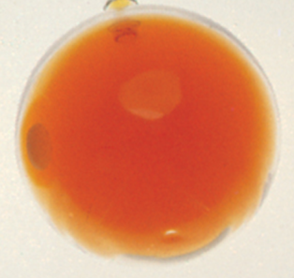

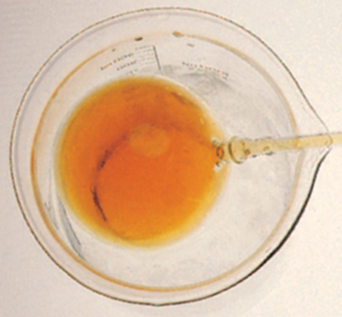
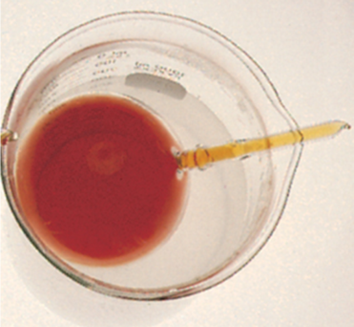
Example
N₂O_{4(g)} 2NO_{2(g)}
colorless
orange
Heat + N₂O_{4(g)} 2NO_{2(g)}
Which way does the reaction shift if:
we put it in an ice water bath?
K decreases
Heat + N₂O_{4(g)} 2NO_{2(g)}
we put it in a hot water bath?
K increases
Heat + N₂O_{4(g)} 2NO_{2(g)}

Slide 40
Question:
Does an increase in temperature cause the following reactions to:
A) Shift Left B) Stay the same C) Shift right
(1) CaO_{(s)} + H₂O_{(g)} Ca(OH)_{2(aq)} ΔH° = -82 kJ
(2) CaCO_{3(s)} CaO_{(s)} + CO_{2(g)} ΔH° = 178 kJ
(3) SO_{2(g)} S_{(s)} + O_{2(g)} ΔH° = 297 kJ

Slide 41
Factors that Affect Equilibrium
At equilibrium:
aA + bB cC + dD
How we will “poke” our equilibrium:
Concentration
Pressure
Temperature
Catalyst

Slide 42
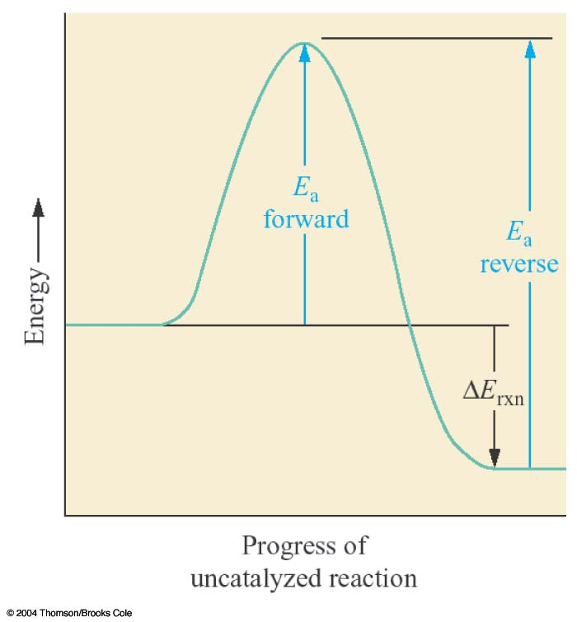
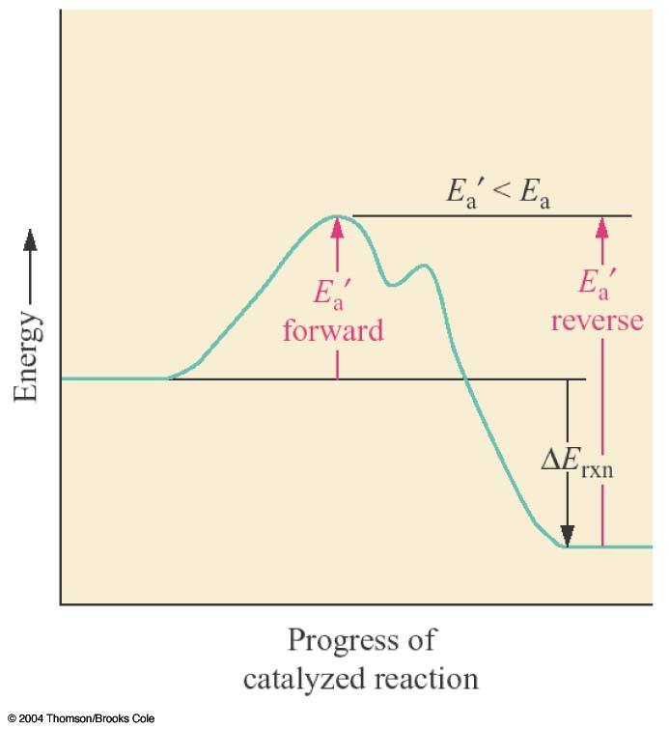
Addition of a Catalyst
A catalyst speeds up a reaction by lowering its activation energy.
It speeds up the forward and reverse reactions equally.
A catalyst causes a reaction to reach equilibrium more quickly.
It does not change the equilibrium concentration or K.

Slide 43
Question:
How will the addition of a catalyst affect the equilibrium
2SO₂(g) + O₂(g) ↔ 2 SO₃(g)
CO(g) + H₂O(g) ↔ CO₂(g) + H₂(g)
CO(g) + Cl₂(g) ↔ COCl₂(g)
N₂O₄(g) ↔ 2 NO₂(g)
CO(g) + 2H₂(g) ↔ CH₃OH(g)
A) Shift Left B) Stay the same C) Shift right

Slide 44
Factors that Affect Equilibrium
At equilibrium:
aA + bB cC + dD
How we will “poke” our equilibrium:
Concentration
Pressure
Temperature
Catalyst

Slide 45
LCP Summary
Change Equilibrium
Constant
Change
Shift Equilibrium
Concentration
yes
no
Volume
yes*
no
Temperature
yes
yes
Catalyst
no
no
*Dependent on relative moles of gaseous reactants and products

Slide 46
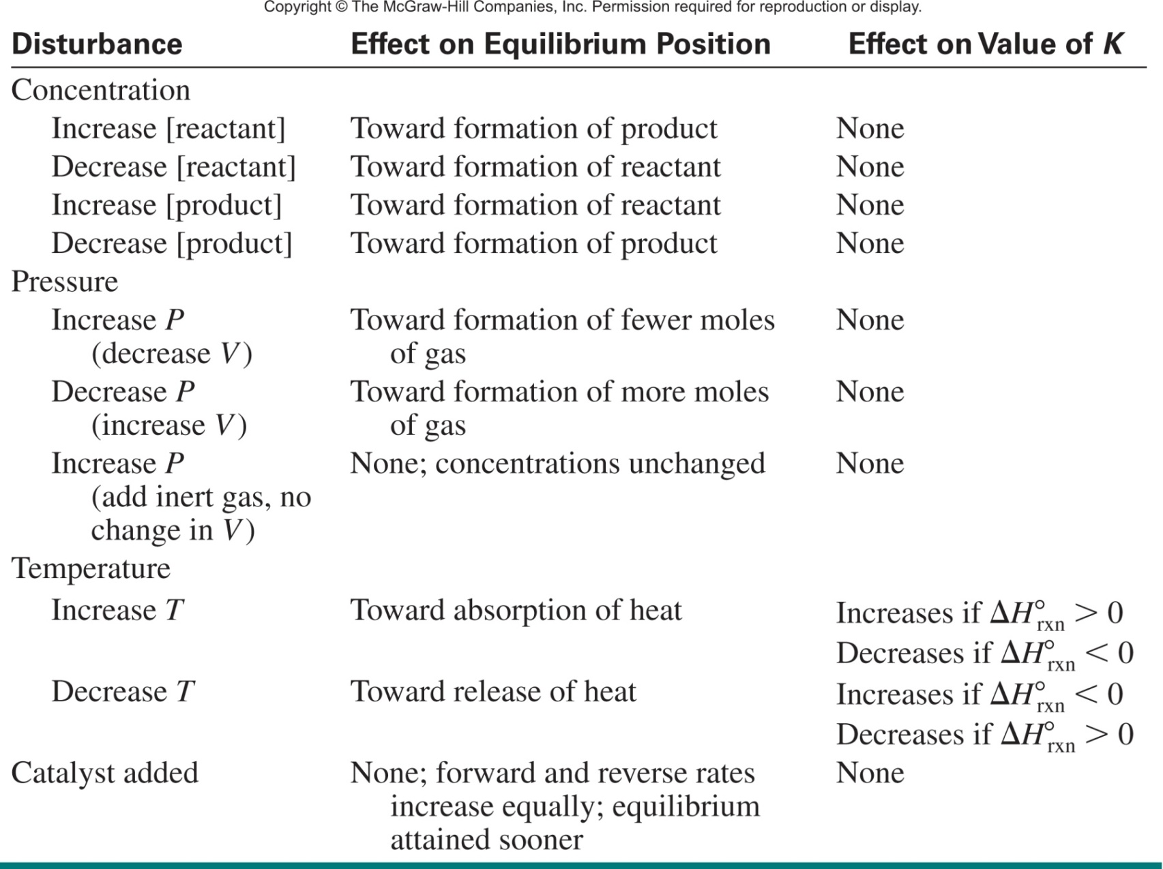
Table 17.4 Effects of Various Disturbances on a System at Equilibrium

Slide 47
Consider the following equilibrium process between dinitrogen tetrafluoride (N₂F₄) and nitrogen difluoride (NF₂):
N₂F₄(g) 2NF₂(g) ΔH° = 38.5 kJ/mol
Predict the changes in the equilibrium and K if:
the reacting mixture is heated at constant volume.
(b) some N₂F₄ gas is removed from the reacting mixture at constant temperature and volume.
(c) the pressure on the reacting mixture is decreased at constant temperature.
(d) a catalyst is added to the reacting mixture.

Slide 48
Consider the following equilibrium process between dinitrogen tetrafluoride (N₂F₄) and nitrogen difluoride (NF₂):
N₂F₄(g) 2NF₂(g) ΔH° = 38.5 kJ/mol
Predict the changes in the equilibrium and K if:
the reacting mixture is heated at constant volume.
Heat + N₂F_{4(g)} 2NF_{2(g)}
Reaction shifts right, generates more product and increase K.

Slide 49
Consider the following equilibrium process between dinitrogen tetrafluoride (N₂F₄) and nitrogen difluoride (NF₂):
N₂F₄(g) 2NF₂(g) ΔH° = 38.5 kJ/mol
Predict the changes in the equilibrium and K if:
(b) some N₂F₄ gas is removed from the reacting mixture at constant temperature and volume.
Heat + N₂F_{4(g)} 2NF_{2(g)}
Reaction shifts left, generates more reactants and K stays the same.

Slide 50
Consider the following equilibrium process between dinitrogen tetrafluoride (N₂F₄) and nitrogen difluoride (NF₂):
N₂F₄(g) 2NF₂(g) ΔH° = 38.5 kJ/mol
Predict the changes in the equilibrium and K if:
(c) the pressure on the reacting mixture is decreased at constant temperature.
pressure
decrease
volume increase
=
Heat + N₂F_{4(g)} 2NF_{2(g)}
1 gas molecule
2 gas molecules
Reaction shifts right, generates more products and K stays the same.

Slide 51
Consider the following equilibrium process between dinitrogen tetrafluoride (N₂F₄) and nitrogen difluoride (NF₂):
N₂F₄(g) 2NF₂(g) ΔH° = 38.5 kJ/mol
Predict the changes in the equilibrium and K if:
(d) a catalyst is added to the reacting mixture.
Heat + N₂F_{4(g)} 2NF_{2(g)}
A catalyst causes a reaction to reach equilibrium more quickly.
It does not change the equilibrium concentration or K.

Slide 52
Real World Application
Haber-Bosch process:
N_{2(g)} + 3H_{2(g)} 2NH_{3(g)}
ΔH°_{rxn} = -91.8 kJ
You are tasked with feeding 7.3 billion people. NH₃ is crucial to increasing food production by maximizing crop yield.
How do you increase the rate of product formation?
Build more reactors.
Increase the temperature.
Add a catalyst.
How do you shift the equilibrium to favor products?
Decrease the temperature.
Increase the pressure.
Decrease [NH₃] by removing NH₃ as it forms.
Add more H₂ and N₂ as its consumed.

Slide 53
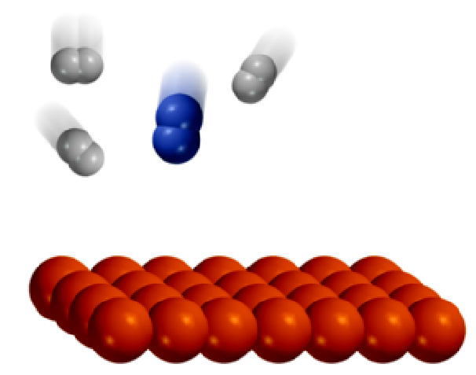
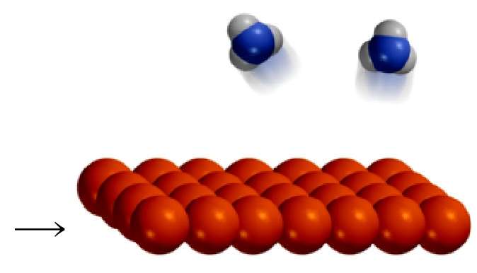
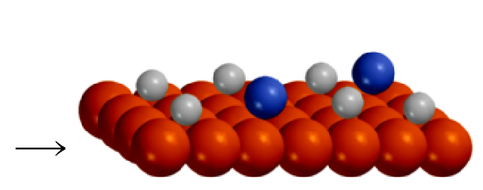
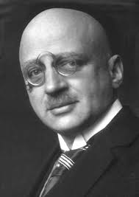
Important Heterogeneous Reactions
Haber-Bosch Reaction
150 atm
400-600 °C
Fe/Al₂O₃
N₂ (g) + 3H₂ (g) 2NH₃ (g)
catalyst
Fritz Haber
1918 Nobel Prize in Chemistry

Slide 54
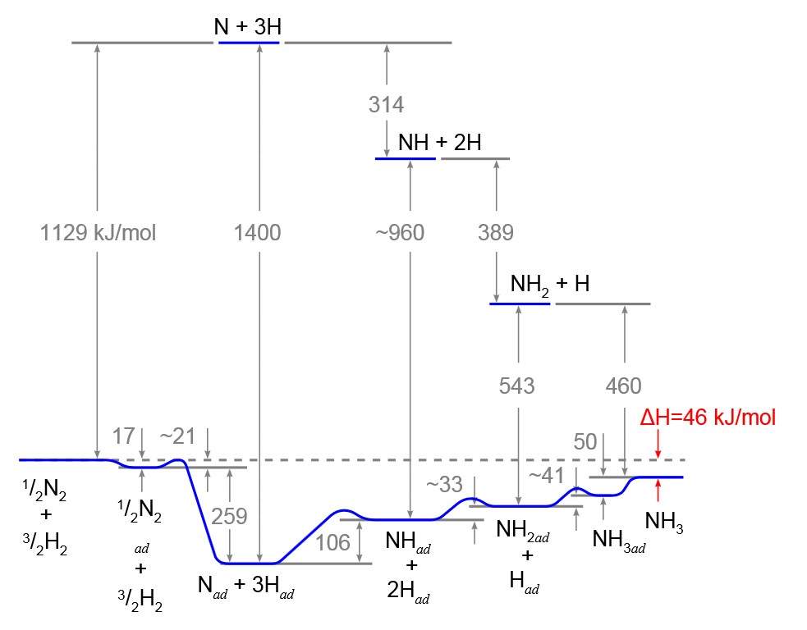
Haber-Bosch Process
Uncatalyzed
N₂ + 3H₂ 2NH₃
Catalyst gets you to NH₃ quicker but the [NH₃] is dictated by K.
Catalyzed

Slide 55
Real World Application
Haber-Bosch process:
N_{2(g)} + 3H_{2(g)} 2NH_{3(g)}
ΔH°_{rxn} = -91.8 kJ
You are tasked with feeding 7.3 billion people. NH₃ is crucial to increasing food production by maximizing crop yield.
How do you increase the rate of product formation?
Build more reactors.
Increase the temperature.
Add a catalyst.
How do you shift the equilibrium to favor products?
Decrease the temperature.
Increase the pressure.
Decrease [NH₃] by removing NH₃ as it forms.
Add more H₂ and N₂ as its consumed.

Slide 56
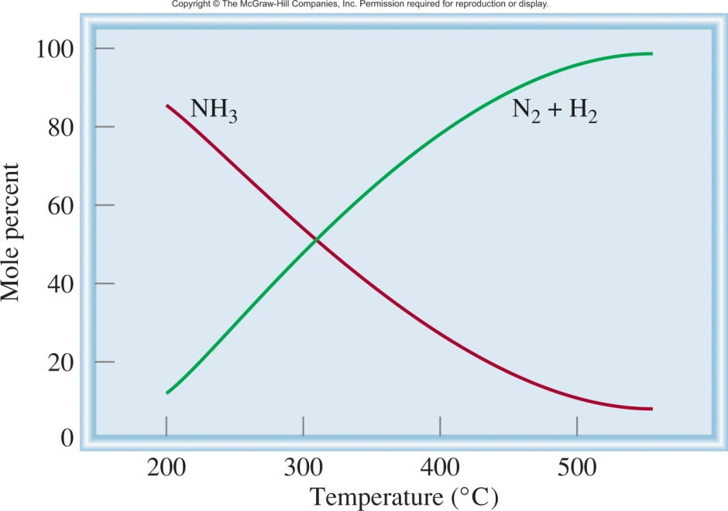
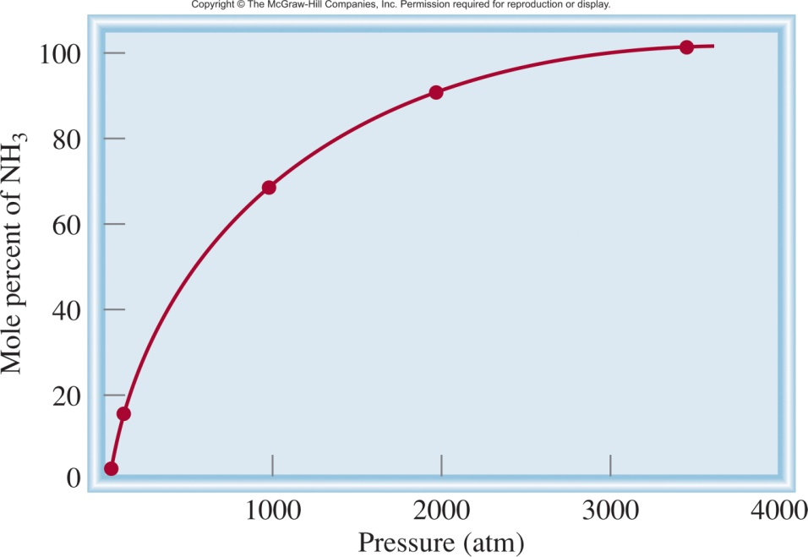
Haber-Bosch Process
N_{2(g)} + 3H_{2(g)} 2NH_{3(g)}
ΔH°_{rxn} = -91.8 kJ
Which way does the reaction shift if:
slow
fast
we increase the temperature?
Reaction shifts left, less NH₃.
But…it gets there faster!
we decrease the temperature?
Reaction shifts right, more NH₃.
But…it gets there slower!
we increase the pressure?
Reaction shifts right, more NH₃.

Slide 57
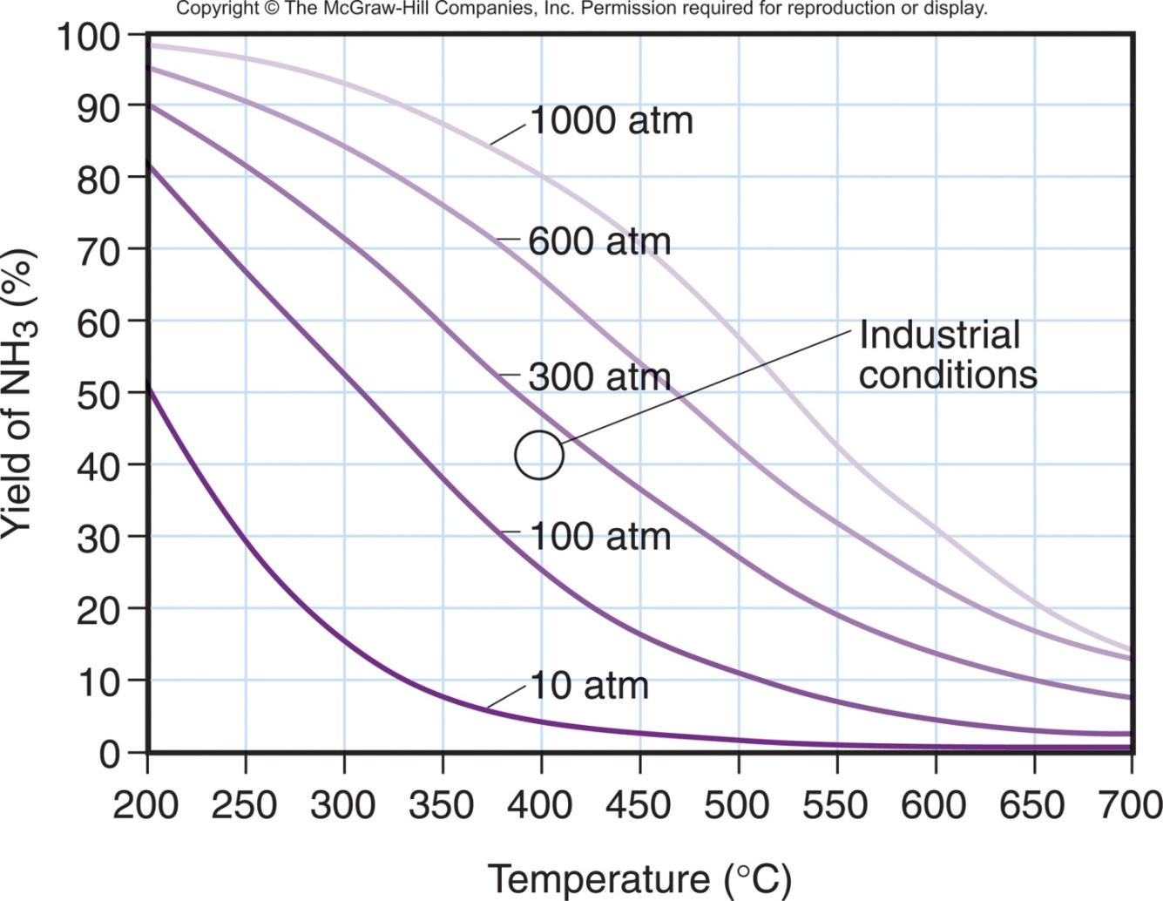
Haber-Bosch Process
N_{2(g)} + 3H_{2(g)} 2NH_{3(g)}
slow
ΔH°_{rxn} = -91.8 kJ
Which way does the reaction shift if:
we increase the temperature?
Reaction shifts left, less NH₃.
But…it gets there faster!
fast
we decrease the temperature?
Reaction shifts right, more NH₃.
But…it gets there slower!
At very high P and low T (top left), the yield is high, but the reaction is slow. Industrial conditions (circle) are between 200 and 300 atm at about 400°C.
we increase the pressure?
Reaction shifts right, more NH₃.

Slide 58
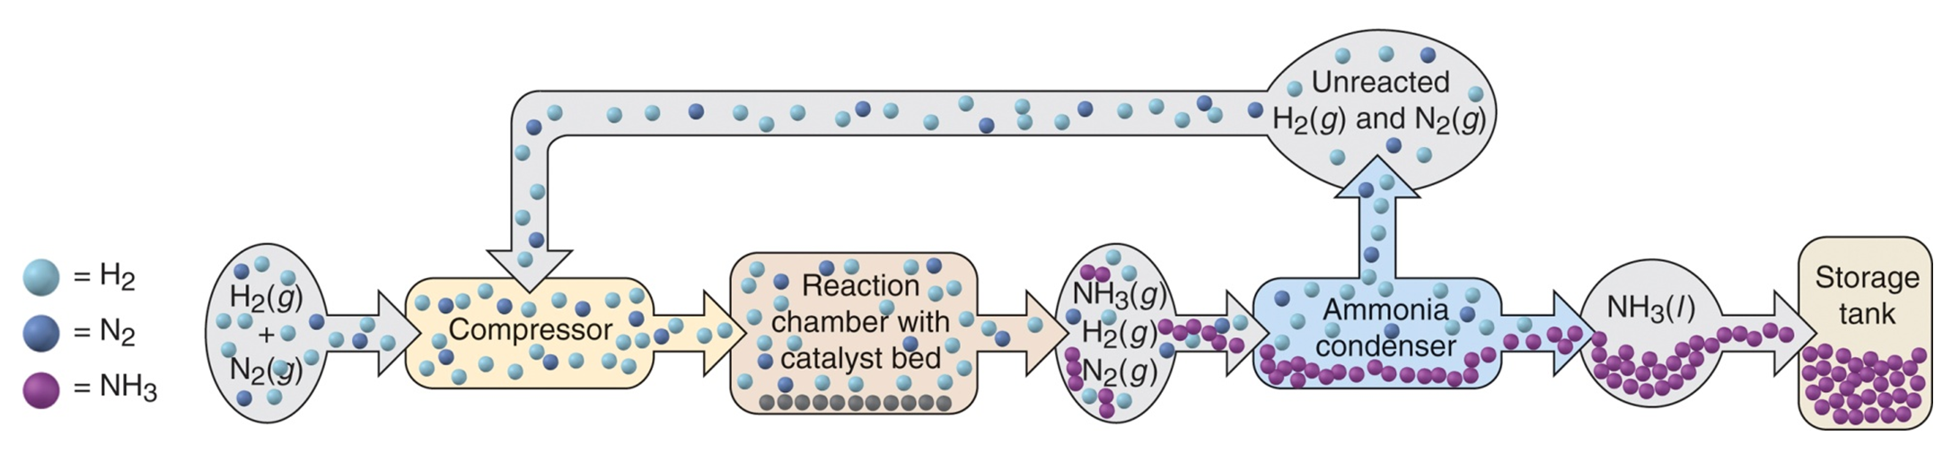
Haber-Bosch Process
N_{2(g)} + 3H_{2(g)} 2NH_{3(g)}
ΔH°_{rxn} = -91.8 kJ
300 atm at 400°C
Increase the product formation rate:
Add a catalyst.
Increase the temperature.
Shift the equilibrium:
Decrease the temperature.
Increase the pressure.
Decrease [NH₃] by removing NH₃ as it forms.
Add more H₂ and N₂ as its consumed.

Slide 60

Going one step further
If we are given the concentrations in a reaction mixture and K_{c} we can predict which direction the reaction will proceed.
Q = K : the system is at equilibrium
Q < K : the reaction proceeds to the right
Q > K : the reaction proceeds to the left
We can also calculate the concentrations of each species when it reaches equilibrium.
Reaction Table
ICE Table/Method

Slide 61
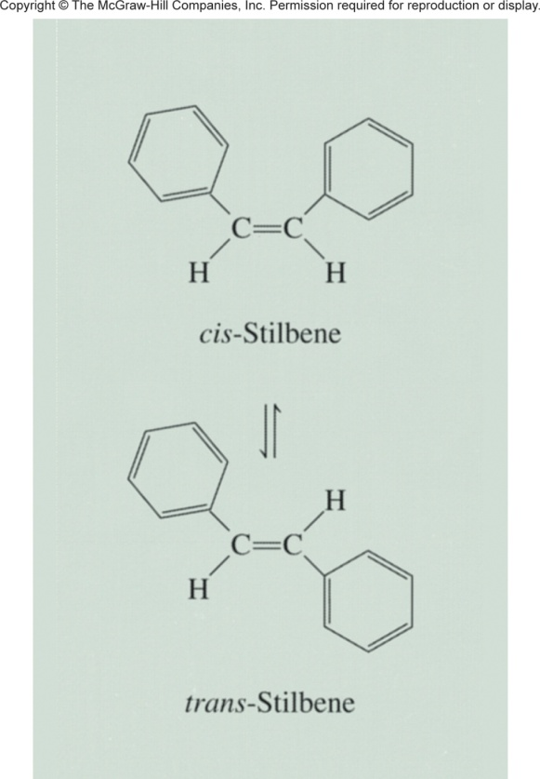
ICE Method
cis-stilbene trans-stilbene
The equilibrium constant (K_{c}) for this system is 24.0 at 200°C. Suppose that initially only cis-stilbene is present at a concentration of 0.850 mol/L. How do we calculate the concentrations of cis- and trans-stilbene at equilibrium?
Step 1: Construct an ICE Table.
Step 2: Insert known information into ICE Table (in M or pressure).
Step 3: Determine the change in conc (x) that will occur as the reaction progresses.
Step 4: Complete the table.
Step 5: Set up K equation, calculate x.
Step 6: Calculate equilibrium concs.

Slide 62
ICE Method
cis-stilbene trans-stilbene
The equilibrium constant (K_{c}) for this system is 24.0 at 200°C. Suppose that initially only cis-stilbene is present at a concentration of 0.850 mol/L. How do we calculate the concentrations of cis- and trans-stilbene at equilibrium?
Step 1: Construct an ICE Table.
Reactants Products
Initial (M):
Change (M):
Equilibrium (M):
cis-stilbene trans-stilbene

Slide 63
ICE Method
cis-stilbene trans-stilbene
The equilibrium constant (K_{c}) for this system is 24.0 at 200°C. Suppose that initially only cis-stilbene is present at a concentration of 0.850 mol/L. How do we calculate the concentrations of cis- and trans-stilbene at equilibrium?
Step 2: Insert known information into ICE Table (in M or pressure).
Reactants Products
Initial (M):
Change (M):
Equilibrium (M):
cis-stilbene trans-stilbene
0.850
0

Slide 64
ICE Method
cis-stilbene trans-stilbene
The equilibrium constant (K_{c}) for this system is 24.0 at 200°C. Suppose that initially only cis-stilbene is present at a concentration of 0.850 mol/L. How do we calculate the concentrations of cis- and trans-stilbene at equilibrium?
Step 3: Determine the change in conc (x) that will occur.
Reactants Products
Initial (M):
Change (M):
Equilibrium (M):
cis-stilbene trans-stilbene
0.850
0
-x
+x
[trans]
Q
=
= 0
[cis]

Slide 65
ICE Method
cis-stilbene trans-stilbene
The equilibrium constant (K_{c}) for this system is 24.0 at 200°C. Suppose that initially only cis-stilbene is present at a concentration of 0.850 mol/L. How do we calculate the concentrations of cis- and trans-stilbene at equilibrium?
Step 4: Complete the table.
Reactants Products
Initial (M):
Change (M):
Equilibrium (M):
cis-stilbene trans-stilbene
0.850
0
-x
+x
(0.850 - x)
x

Slide 66
ICE Method
cis-stilbene trans-stilbene
The equilibrium constant (K_{c}) for this system is 24.0 at 200°C. Suppose that initially only cis-stilbene is present at a concentration of 0.850 mol/L. How do we calculate the concentrations of cis- and trans-stilbene at equilibrium?
Step 5: Set up K equation, calculate x.
Reactants Products
Initial (M):
Change (M):
Equilibrium (M):
cis-stilbene trans-stilbene
0.850
0
-x
+x
(0.850 - x)
x
[trans]
x
K
=
= 24
=
x = 0.816 M
[cis]
0.850 - x

Slide 67
ICE Method
cis-stilbene trans-stilbene
The equilibrium constant (K_{c}) for this system is 24.0 at 200°C. Suppose that initially only cis-stilbene is present at a concentration of 0.850 mol/L. How do we calculate the concentrations of cis- and trans-stilbene at equilibrium?
Step 5: Set up K equation, calculate x.
Reactants Products
Initial (M):
Change (M):
Equilibrium (M):
cis-stilbene trans-stilbene
0.850
0
-x
+x
x = 0.816 M
(0.850 - x)
x
Equilibrium:
0.034 M
0.816 M

Slide 68
More Complex Example
The equilibrium constant K_{c} for the reaction H_{2(g)} + I_{2(g)} 2HI_{(g)} is 54.3 at 430°C. Suppose that the initial concentrations of H₂, I₂, and HI are 0.00623 M, 0.00414 M, and 0.0224 M, respectively. Calculate the concentrations of these species at equilibrium.
H_{2(g)} + I_{2(g)} 2HI_{(g)}
[HI]²
K
=
= 54.3
[H₂]
[I₂]

Slide 69
More Complex Example
The equilibrium constant K_{c} for the reaction H_{2(g)} + I_{2(g)} 2HI_{(g)} is 54.3 at 430°C. Suppose that the initial concentrations of H₂, I₂, and HI are 0.00623 M, 0.00414 M, and 0.0224 M, respectively. Calculate the concentrations of these species at equilibrium.
Reactants Products
Initial (M):
Change (M):
Equilibrium (M):
H_{2(g)} + I_{2(g)} 2HI_{(g)}
0.00623
0.00414
0.0224
- x
- x
2x
(0.00623 – x)
(0.00414 – x)
0.0224 + 2x

Slide 70
More Complex Example
Then math happens!
=
54.3(2.58 x 10⁻⁵ - 0.0104x + x²) = 5.02 x 10⁻⁴ + 0.0896x + 4x²
50.3x² - 0.654x + 8.98 x 10⁻⁴ = 0
This is a quadratic equation of the form ax² + bx + c = 0.
(a = 50.3, b = -0.654, and c = 8.98 x 10⁻⁴)

Slide 71
More Complex Example
The equilibrium constant K_{c} for the reaction H_{2(g)} + I_{2(g)} 2HI_{(g)} is 54.3 at 430°C. Suppose that the initial concentrations of H₂, I₂, and HI are 0.00623 M, 0.00414 M, and 0.0224 M, respectively. Calculate the concentrations of these species at equilibrium.
Reactants Products
Initial (M):
Change (M):
Equilibrium (M):
H_{2(g)} + I_{2(g)} 2HI_{(g)}
0.00623
0.00414
0.0224
- x
- x
2x
(0.00623 – x)
(0.00414 – x)
0.0224 + 2x
Equilibrium:
Question :
A
B

Slide 72

More Complex Example
The equilibrium constant K_{c} for the reaction H_{2(g)} + I_{2(g)} 2HI_{(g)} is 54.3 at 430°C. Suppose that the initial concentrations of H₂, I₂, and HI are 0.00623 M, 0.00414 M, and 0.0224 M, respectively. Calculate the concentrations of these species at equilibrium.
Reactants Products
Initial (M):
Change (M):
Equilibrium (M):
H_{2(g)} + I_{2(g)} 2HI_{(g)}
0.00623
0.00414
0.0224
- x
- x
2x
(0.00623 – x)
(0.00414 – x)
0.0224 + 2x
Equilibrium:
0.00467 M
0.00258 M
0.0255 M

Slide 73
There has to be a better way!
Sometimes close enough is good enough!
We can assume that [A]_{init} – x ≈ [A]_{init} if:
K_{c} is relatively small
and/or
[A]_{init} is relatively large.
[A]_{init}
K_{c}
If > 400,
the assumption is justified; neglecting x introduces an error < 5%.
[A]_{init}
K_{c}
If < 400,
the assumption is not justified; neglecting x introduces an error > 5%.

Slide 74
Another Example
A reaction chamber contains 0.8 M of N₂, 0.2 M of oxygen, and 0 M of NO at 1500 K. Is the mixture at equilibrium. If not, which way will it shift and by how much?
N₂ + O₂ 2 NO
K_{c} = 1.0 x 10^{–5} at 1500 K
[NO]²
(0)²
Q =
=
= 0
[N₂]
[O₂]
(0.8)
(0.2)

Slide 75
Another Example
A reaction chamber contains 0.8 M of N₂, 0.2 M of oxygen, and 0 M of NO at 1500 K. Is the mixture at equilibrium. If not, which way will it shift and by how much?
K_{c} = 1.0 x 10^{–5}
Reactants Products
Initial (M):
Change (M):
Equilibrium (M):
N_{2(g)} + O_{2(g)} 2NO_{(g)}
0.8
0.2
0
- x
- x
+ 2x
(0.8 – x)
(0.2 – x)
2x
[NO]²
(2x)²
K =
=
[N₂]
[O₂]
(0.8 - x)
(0.2 - x)
4x² + 0.00399x + 1.6 x 10⁻⁶ = 0
etc.

Slide 76
Another Example
A reaction chamber contains 0.8 M of N₂, 0.2 M of oxygen, and 0 M of NO at 1500 K. Is the mixture at equilibrium. If not, which way will it shift and by how much?
K_{c} = 1.0 x 10^{–5}
Reactants Products
Initial (M):
Change (M):
Equilibrium (M):
N_{2(g)} + O_{2(g)} 2NO_{(g)}
0.8
0.2
0
- x
- x
+ 2x
(0.8 – x)
(0.2 – x)
2x
but…
0.8
0.00001
0.2
0.00001
[A]_{init}
K_{c}
= 80000
= 20000
If > 400
we can neglect x

Slide 77
Another Example
A reaction chamber contains 0.8 M of N₂, 0.2 M of oxygen, and 0 M of NO at 1500 K. Is the mixture at equilibrium. If not, which way will it shift and by how much?
K_{c} = 1.0 x 10^{–5}
Reactants Products
Initial (M):
Change (M):
Equilibrium (M):
N_{2(g)} + O_{2(g)} 2NO_{(g)}
0.8
0.2
0
- x
- x
+ 2x
(0.8 – x)
(0.2 – x)
2x
[NO]²
(2x)²
(2x)²
K =
=
=
[N₂]
[O₂]
(0.8 - x)
(0.2 - x)
(0.8)
(0.2)
x = 6.3 x 10 ^{–4}

Slide 78
Another Example
A reaction chamber contains 0.8 M of N₂, 0.2 M of oxygen, and 0 M of NO at 1500 K. Is the mixture at equilibrium. If not, which way will it shift and by how much?
K_{c} = 1.0 x 10^{–5}
Reactants Products
Initial (M):
Change (M):
Equilibrium (M):
N_{2(g)} + O_{2(g)} 2NO_{(g)}
0.8
0.2
0
- x
- x
+ 2x
(0.8 – x)
(0.2 – x)
2x
Equilibrium:
0.8 M
0.2 M
0.0013 M
[NO]²
(0.0013)²
x = 6.3 x 10 ^{–4}
K =
=
= 1.05 x 10⁻⁵
[N₂]
[O₂]
(0.8)
(0.2)
Within 5% error!

Slide 79
ICE Method
PRELIMINARY SETTING UP
Write the balanced equation.
Write the reaction quotient, Q.
Convert all amounts into the correct units (M or atm).
WORKING ON THE REACTION TABLE
When reaction direction is not known, compare Q with K.
Construct a reaction table.
✓ Check the sign of x, the change in the concentration (or pressure).

Slide 80
ICE Method
SOLVING FOR x AND EQUILIBRIUM QUANTITIES
Substitute the quantities into K equation.
To simplify the math, assume that x is negligible:
([A]_{init} – x = [A]_{eq} ≈ [A]_{init})
Solve for x.
Find the equilibrium quantities.
✓ Check that assumption is justified (<5% error). If not, solve quadratic equation for x.
✓ Check to see that calculated values give the known K.

